Slide 1
CSCI262 : System Security
Access Control 2

Slide 2
Schedule
Security Model
Confidential Policies
Integrity Policies
Hybrid Policies

Slide 3
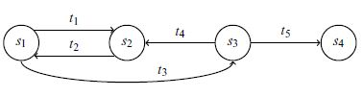
Security Policies
A security policy is a statement that partitions the states of the system into a set of authorised, or secure, states and a set of unauthorised, or nonsecure, states.
A secure system is a system that starts in an authorised state and cannot enter an unauthorised state.
Example: (from [B18])
  Authorised state set {s₁,s₂}
  Unauthorised state set {s₃,s₄}
  The system is not secure
Figure 4-1 in [B18]
Notes:
The system is not secure because regardless of which authorized state it starts in, it can enter
an unauthorized state. However, if the edge from s1 to s3 were not present, the
system would be secure, because it could not enter an unauthorized state from an
authorized state.

Slide 4
Security model
A security model is a precise representation of the security requirements (security policy).
Characteristics:
  Simple and abstract.
  Precise and unambiguous.
  Generic.
    Deals with security properties.
    Does not unduly constrain system functions or implementation details.
In state machine representations, we:
  Describe the system as an abstract mathematical state machine.
  Represent the state of the machine using state variables.
  Describe how variables, and thus the state, changes using transition functions.
Notes:
BLP is a security model for access control. That we will learn shortly

Slide 5
Traditional Security Models
System : <Subjects, Objects>
Subjects : Active Entities
: Users, Processes
Objects : Passive Entities
: Files, Records
Security Relevant State Variables:
<Subjects, Objects, Security Attributes>

Slide 6
State machine based security model
To prove security of a particular state machine based system we use the following procedure:
1. Define appropriate state variables.
  State relationships between them.
2. Define conditions for a secure state:
  This includes the relationships between values of state variables that must be maintained during state transitions.
  These are security constraints.
3. Define state transition functions:
  Define the mechanisms by which state variables can change.

Slide 7
4. Prove each transition function maintains a secure state, when acting on a secure state.
5. Define an initial state.
6. Show the initial state is secure.
We then apply induction to show evolution of the system must leave it secure, by 4. and 6.
Transition
State
State'
Secure
Secure

Slide 8
Example
S = {S1, S2, S3}
O = {O1 , O2 , O3 }
A ={read, write, execute}
The state variables are combinations <S_{i},O_{j},A_{k}> of these which can effectively be on or off, with on corresponding to that action currently being active between S and O.
Conditions for a secure state (we will see shortly):
  ss-property.
  *-property.
  ds-property.

Slide 9
Confidentiality policies
A confidentiality policy, also called information flow policy, prevents the unauthorised disclosure of information
Bell-LaPadula (BLP) Model
  is a confidentiality based access control model
  corresponds to military-type classifications
    Developed primarily to provide confidentiality
  has influenced the development of many other models and computer security technologies

Slide 10
The (simplified) Bell-LaPadula Model
The Bell-LaPadula Model (1973, 1975) is a multilevel security model which works by specifying allowable paths of information flow in a secure system.
This is an important model when a system/machine has to concurrently handle data at different sensitivity levels. For example, a machine processing confidential and top-secret files at the same time.
Notes:
The BLP model was developed in the 1970s as a formal model for access control.
The Bell-LaPadula Model (BLM), also called the multi-level model, was proposed by Bell and LaPadula for enforcing access control in government and military applications. In such applications, subjects and objects are often partitioned into different security levels. A subject can only access objects at certain levels determined by his security level. For instance, the following are two typical access specifications: ``Unclassified personnel cannot read data at confidential levels'' and ``Top-Secret data cannot be written into the files at unclassified levels''.
In the model, each subject and each object is assigned a security class. In the simplest
formulation, security classes form a strict hierarchy and are referred to as security
levels.

Slide 11
The components of the model are as follows:
  A set of objects O={O_{i}}.
  A set of subjects S={S_{i}}.
  A set of access operations A = {execute, read, write, append}.
    Append is writing only. Write is being allowed to read and write ☹
  A set of security levels L with a partial order ≤.
    (L, ≤) defines a lattice.
    In this simplified model the lattice is reduced to a linear structure.
Notes:
Partial order : reflexive a <= a
, antisymmetric: a<+b, b<=a -> a= b
transitivity: a<=b, b<= c then a<=c

Slide 12
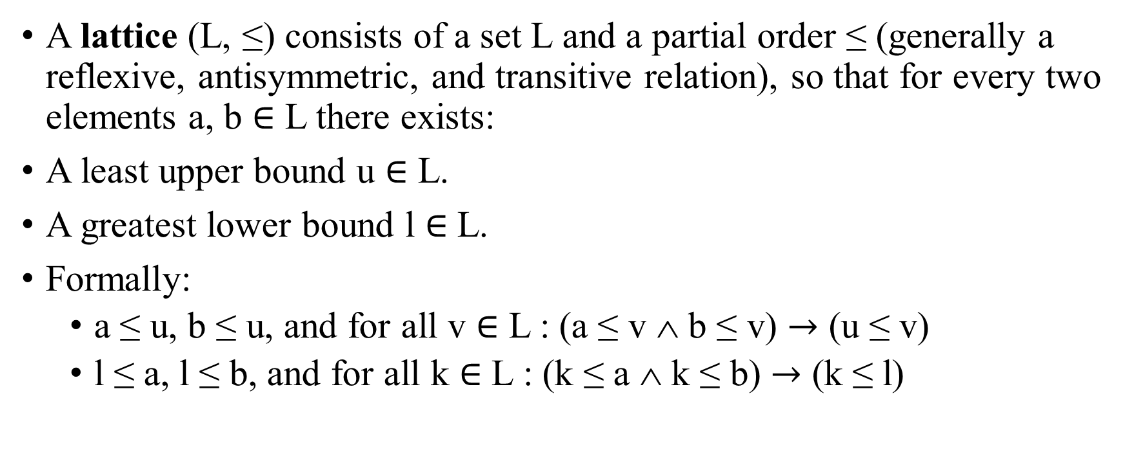
Lattices
A lattice (L, ≤) consists of a set L and a partial order ≤ (generally a reflexive, antisymmetric, and transitive relation), so that for every two elements a, b $∈$ L there exists:
A least upper bound u $∈$ L.
A greatest lower bound l $∈$ L.
Formally:
  a ≤ u, b ≤ u, and for all v $∈$ L : (a ≤ v ∧ b ≤ v) $→$ (u ≤ v)
  l ≤ a, l ≤ b, and for all k $∈$ L : (k ≤ a ∧ k ≤ b) $→$ (k ≤ l)

Slide 13
Properties of the relation ≤
Reflexive: a ≤ a.
Antisymmetric: If a ≤ b and b ≤ a then a = b.
Transitive: If a ≤ b and b ≤ c then a ≤ c.
An important term:
  If a ≤ b, b dominates a → b dom a
  Domination can be interpreted as meaning requiring a higher security level.

Slide 14
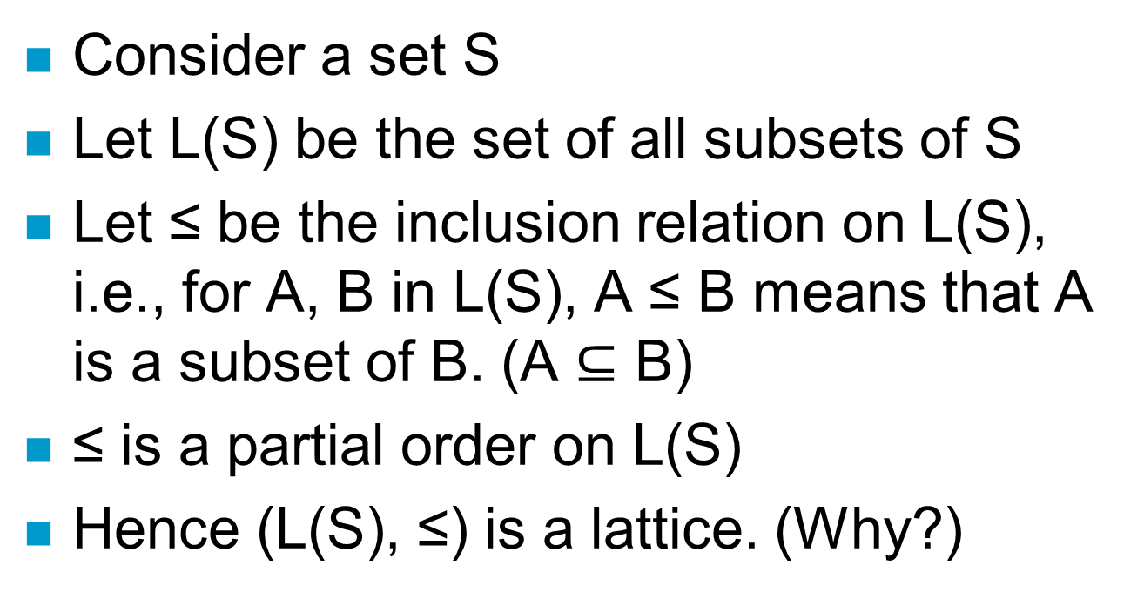
Another example
Notes:
Explain in whiteboard

Slide 15
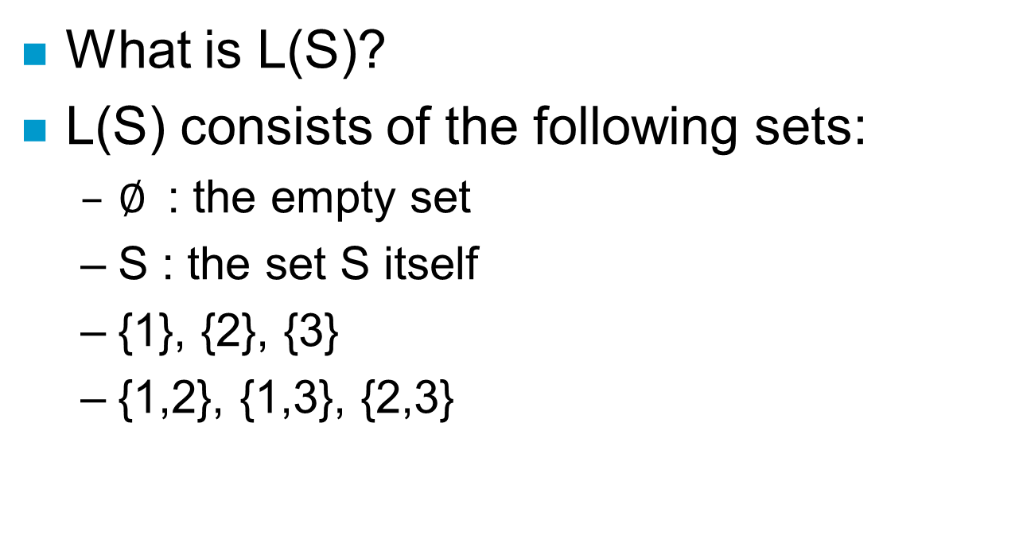
Lattice diagram for S = {1,2,3}

Slide 16
S= {1,2,3}
{1,2}
{1,3}
{2,3}
{1}
{2}
{3}
{∅}

Slide 17
BLP system state
The state of a system is described by the 4-tuple (b,M,f,H):
Current access set b:
  Triples (subject, object, operation).
  The triple (S_{i},O_{j},a) is interpreted as “S_{i} is currently doing a with respect to O_{j}”.
  The only triples that exist are allowed ones, otherwise the activity couldn’t take place.
Access matrix M:
  As described earlier, this indicates which operations a subject can perform an object. Each element of the matrix is labelled M[S_{i},O_{j}] and contains a list of allowed actions.

Slide 18
Level function f: This consists of three mappings with overall responsibility for assigning security levels to each subject and to each object.
  f_{o}(O_{i}) produces the classification level of O_{i}.
  f_{s}(S_{j}) produces the security clearance of S_{j}.
  f_{c}(S_{j}) produces the current security level of S_{j}. We necessarily have f_{c}(S_{i}) ≤ f_{s}(S_{i}), so that a subject can operate at a lower security clearance than their maximum.
Hierarchy H:
  A directed rooted tree with the nodes being the objects.
  This ties into the lattice.
  The BLP model requires that the security level of an object dominates the security level of its parent.
  Domination effectively means must be higher.

Slide 19
BLP properties: 2 Mandatory
The mandatory properties of BLP are characterised by the phrase:
“No write down, no read up!” (ss and *)
As a whole the properties are designed to protect against unauthorized disclosure of information.
ss – property:
(S_{i},O_{j},read) can be in b iff f_{o}(O_{j}) ≤ f_{c}(S_{i}).
Turning this around: The state (b,M,f,H) has the ss–property if, for every (S_{i},O_{j},read) ∈ b, we have that f_{o}(O_{j}) ≤ f_{c}(S_{i}).

Slide 20
* – property:
  (S_{i},O_{j},append) can be in b iff f_{c}(S_{i}) ≤ f_{o}(O_{j}).
(S_{i},O_{j},read/write) can be in b iff f_{c}(S_{i})=f_{o}(O_{j}).
Notice that we have used = in the last line.
  We effectively define = by
  A = B iff (A ≤ B AND B ≤ A)
Again we can turn this around to determine if the current state (b,M,f,H) has the * – property.

Slide 21
BLP properties: 1 discretionary
ds – property.
This is designed to capture the idea that permission may be passed from an authorised subject to another, level authorised, subject.
(S_{i},O_{j},a) can be in b only if a ∈ M[S_{i},O_{j}].
This can also be turned around to determine if the current state (b,M,f,H) has the ds – property.

Slide 22
An example
Top secret (TS) | Tam, Tom | Personnel files
Secret (S) | Sal, Sam | Email files
Confidential (C) | Cam, Cal | Activity log files
Unclassified (UC) | Uma, Una | Phone lists
Cam and Cal cannot read personnel files, that would be reading up.
Tam, Sam and Cam can all read the activity log files, if the access control matrices allow them to.
Tam and Tom cannot write to the activity log files, that would be writing down.
Uma and Una can write to the activity log files, if the access control matrices allow them to.

Slide 23
Discretionary example …
Top secret (TS) | Tam | Personnel file
Secret (S) | Sam | Email file
Confidential (C) | Cam | Activity log
Unclassified (UC) | Uma | Phone list
 | Personnel file | Email file | Activity log | Phone list
Tam | Read, Write
Sam |  | Read
Cam
Uma |  |  | Write
Tam can read and write the Personnel file.
Sam cannot currently write the Email file.
Cam cannot do anything.
Uma cannot read the Phone list.

Slide 24
Criticism of McLean
What happens if we
  downgrade all subjects to lowest security level
  downgrade all objects to lowest security level
  enter all access rights in the ACM M
Is the system secure?
Notes:
It satisfies every security property of BLP

Slide 25
Tranquility
Consider a system with s₁,s₂,o₁,o₂
  f_{s}(s₁)=f_{c}(s₁)=f_{o}(o₁)=high
  f_{s}(s₂)= f_{c}(s₂)= f_{o}(o₂) =low
And the following execution:
  s₁ gets access to o₁, read something, release access, then change current level to low, get write access to o₂, write to o₂
Every state is secure
Solution: tranquillity principle: subject cannot change current levels, or cannot drop to below the highest level read so far
Notes:
BLP Security Is Not Sufficient!
Tranquility principle
The tranquility principle of the Bell–LaPadula model states that the classification of a subject or object does not change while it is being referenced. There are two forms to the tranquility principle: the "principle of strong tranquility" states that security levels do not change during the normal operation of the system. The "principle of weak tranquility" states that security levels may never change in such a way as to violate a defined security policy. Weak tranquility is desirable as it allows systems to observe the principle of least privilege. That is, processes start with a low clearance level regardless of their owners clearance, and progressively accumulate higher clearance levels as actions require it.

Slide 26
Covert channels
is a type of attack that creates a capability to transfer information objects between processes that are not supposed to be allowed to communicate by the computer security policy.
Require two active agents, one at a low level and the other at a high level and an encoding scheme to pass on information about the high level to the low level
Notes:
A secure system should not only protect against direct revelation of data, but also against violations that produce illegal information flow through indirect means.
● Inference Channels - A user at a low security class uses the lo w data to infer information about high security class.
● Covert channels - Require two active agents, one at a low level and the other at a high level and an encoding scheme to pass on information about the high level to the low level
Covert channels are information channels that are not
controlled by the security mechanism of the system.
Information can flow (leak) from a high security level to a low
security level

Slide 27
Low-level subject s₁ creates object o
High-level accomplice s₂ either
  reclassifies o to its own level (Message 1)
  leaves o unchanged (Message 0)
s₁ tries to access o, which is either
  success (Message 0)
  access denied (Message 1)
One bit of information is transmitted s₂ → s₁
Notes:
Consider the following scenario

Slide 28
The concern is with subjects not users
  Users are trusted (must be trusted) not to disclose secret information outside of the computer system
  Subjects are not trusted because they may have Trojan Horses embedded in the code they execute
Covert channels are typically noisy but information theory techniques can be used to achieve error-free communication
Notes:
Examples of covert channels:
-Using file lock as a shared boolean variable
•By varying its ratio of computing to input/output or its paging rate, the service can transmit information to a concurrently running process
•Timing of packets being sent

Slide 29
Limitations of BLP
only deals with confidentiality, not integrity
  Confidentiality is not important as integrity in many situations
  Limits the access and sharing of information
assumes a fixed rights
  assumes tranquillity
  no model for access management
  no model for policy making
Notes:
allows convert channels

Slide 30
Integrity based access control
A different type of protection is integrity based access control.
  In such models we protect against unauthorised modification of information.
Notice how, for both models, the definitions hinge on the presence of the word unauthorised.

Slide 31
The Biba model
The classical integrity based access control model is the Biba model (1977).
Much of the basis for the model is the same as BLP.
The access modes can be extended to include an Invoke instruction:
  {Modify (Write), Observe (Read), Execute, Invoke (subject to subject communication/use)}
The rules to provide the appropriate policies are, in some sense, the reverse (or dual) of those for BLP.
“No write up, no read down!”
Notes:
BLP: “No write down, no read up!”

Slide 32
Biba is important now because a modified version of it is used in Vista and Windows 7.
  Vista was probably the first commercial use of Biba.
Microsoft has something called MIC: Mandatory Integrity Control.
Read http://www.symantec.com/connect/articles/introduction-windows-integrity-control
Each object is assigned one of six integrity levels: Untrusted, Low, Medium, High, System and Installer.
  Documentation at msdn.microsoft.com notes that in the absence of an integrity label, a medium label is assigned.
Vista has some sort of token-based system for executing privileges and maintaining integrity.

Slide 33
Expanding on the phrase “No write up, no read down!” we have:
  Simple integrity.
  Integrity confinement.
  We also have the invocation property.
Integrity confinement:
  A subject can modify an object if the integrity level of the subject dominates the integrity level of the object. This is the no write up policy.
    Integrity is to do with how much you can rely on something.
    If A, as a process say, is trusted less then B as a resource, then B should not be modified on the basis of A. We shouldn’t contaminate B.

Slide 34
Simple integrity:
  A subject can read an object only if the integrity level of the subject is dominated by the integrity level of the object. This is the no read down policy.
    Juries in court cases are sometimes told to disregard something that has been said, or to ignore some evidence.
      Humans tend to take information into account whether they have been told to disregard it or not, so the no read down policy would imply the jury would never see the untrustworthy evidence.
  Effectively this means a subject doesn’t trust information with a lower integrity level, so it shouldn’t even be influenced by it.

Slide 35
The Invocation property:
  A subject S₁ can invoke/execute/use another subject S₂ only if the integrity level of S₁ dominates the integrity level of S₂.
  In other words, a process cannot use a process or entity that has higher integrity than it does.

Slide 36
Clark-Wilson
Clark-Wilson is another integrity based access model.
It’s also an accountability model providing a framework for addressing security requirements in primarily commercial applications.
  Many early access control models were driven by the military, and even the title of Clark and Wilson’s work suggests a different direction: “A Comparison of Commercial and Military Computer Security Policies.”
  [SB18, Figure 27.5] reproduces a diagram from Clark-Wilson that summarises the integrity rules in Clark-Wilson.
Notes:
David Clark and David Wilson (1987) argued that commercial
security has its own unique concerns and merits a model crafted
for that domain.
The overriding concern is consistency among the various
components of the system state.
Example: In a bank, the funds at the beginning of the day plus
the funds deposited minus the funds withdrawn should equal funds
on hand at the end of the day.
Clark and Wilson claimed that the following are four fundamental
concerns of any reasonable commercial integrity model:
1 Authentication: identity of all users must be properly
authenticated.
2 Audit: modifications should be logged to record every
program executed and by whom, in a way that cannot be
subverted.
3 Well-formed transactions: users manipulate data only in
constrained ways. Only legitimate accesses are allowed.
4 Separation of duty: the system associates with each user a
valid set of programs they can run and prevents unauthorized
modifications, thus preserving integrity and consistency with
the real world.

Slide 37
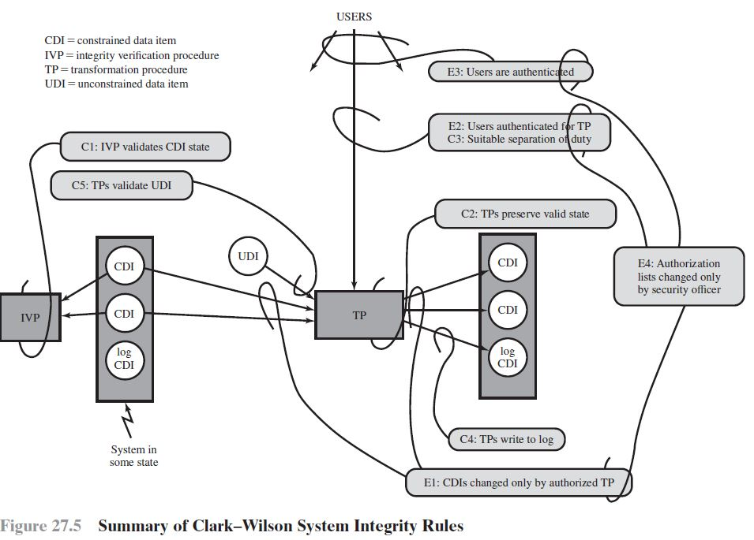
Notes:
The policy is constructed in terms of the following categories:
Constrained Data Items: CDIs are the objects whose
integrity is protected
Unconstrained Data Items: UDIs are objects not covered by
the integrity policy
Transformation Procedures: TPs are the only procedures
allowed to modify CDIs, or take arbitrary user input and
create new CDIs. Designed to take the system from one valid
state to another.
Integrity Verification Procedures: IVPs are procedures
meant to verify maintainance of integrity of CDIs.
Certification rules are security policy restrictions on the behavior of IVPs
and TPs. Enforcement rules are built-in system security mechanisms that achieve
the objectives of the certification rules.
Cl: All IVPs must properly ensure that all CDIs are in a valid state at the time
the IVP is run.
C2: All TPs must be certified to be valid. That is, they must take a CDI to a valid
final state, given that it is in a valid state to begin with. For each TP, and
each set of CDIs that it may manipulate, the security officer must specify a
relation, which defines that execution. A relation is thus of the form (TPi,
(CDIa, CDIb, CDIc . . . )), where the list of CDIs defines a particular set of
arguments for which the TP has been certified.
El: The system must maintain the list of relations specified in rule C2 and
must ensure that the only manipulation of any CDI is by a TP, where the
TP is operating on the CDI as specified in some relation.
E2: The system must maintain a list of relations of the form (UserID, TPi,
(CDIa, CDIb, CDIc, . . . )), which relates a user, a TP, and the data objects
that TP may reference on behalf of that user. It must ensure that only
executions described in one of the relations are performed.
C3: The list of relations in E2 must be certified to meet the separation of duty
requirement.
E3: The system must authenticate the identity of each user attempting to
execute a TP.
C4: All TPs must be certified to write to an append-only CDI (the log) all information
necessary to permit the nature of the operation to be reconstructed.
C5: Any TP that takes a UDI as an input value must be certified to perform
only valid transformations, or else no transformations, for any possible
value of the UDI. The transformation should take the input from a UDI
to a CDI, or the UDI is rejected. Typically, this is an edit program.
E4: Only the agent permitted to certify entities may change the list of such
entities associated with other entities: specifically, the list of TPs associated
with a CDI and the list of users associated with a TP. An agent that can
certify an entity may not have any execute rights with respect to that entity.

Slide 38
Integrity and confidentiality
What happens if we combine Biba and BLP?
“No read up, no write down!”
“No write up, no read down!”
Hmm ...
... “Read and Write across”? ☹
Notes:
Steve Lipner (Microsoft) described some integrity
concerns you might find in a commercial data processing
environment:
1 Users will not write their own programs, but use existing
production software.
2 Programmers develop and test applications on a
nonproduction system, possibly using contrived data.
3 Moving applications from development to production requires
a special process.
4 This process must be controlled and audited.
5 Managers and auditors must have access to system state and
system logs.
Can we use our existing modeling mechanisms to build a secure
system that addresses such constraints?

Slide 39
Lipner’s model
The difference lies in the clearances and classifications.
We have a lattice here rather than the simple levels, and we have a lattice associated with integrity and a lattice associated with confidentiality.
This can be illustrated using an example pulled straight out of [B18, Chapter 6].
  Bishop demonstrates how some of the confidentiality categories can be eliminated by the introduction of integrity categories.
  There are a lot of possible levels, but not all of them are needed/used in practice.
Notes:
Lipner devised his Integrity Matrix Model to handle those concerns
via a combination of BLP and Biba Integrity.

Slide 40
Labels in a combined model …
The language used to describe the levels differs between a confidentiality setting and an integrity setting.
For example, the sensitivity levels may be:
    top secret very reliable totally trusted
    Secret reliable mostly trusted
    Confidential a little bit reliable somewhat trusted
    Unclassified unreliable untrusted
BLP: Confidentiality based so would likely use the first column.
Biba: Integrity based so would so likely use the second and third columns.

Slide 41
Classifications for Confidentiality
CAM: Audit Manager: System auditing and management functions.
CSL: System Low: The lowest.
Categories for Confidentiality
CP: Production: Production code and data.
CD: Development: Production programs under development and testing, but not yet in production use.
CSD: Systems Development: System programs under development, but not yet in production use.

Slide 42
Classifications for Integrity
ISP: System programs.
IO: Production programs and development software.
ISL: System Low: The lowest.
Categories for Integrity
ID: Development: Development entities.
IP: Production: Production entities.

Slide 43
Subjects → Users
Users | Confidentiality Clearance | Integrity Clearance / Trust
Ordinary user | (CSL, {CP}) | (ISL, {IP})
Application developer | (CSL, {CD}) | (ISL, {ID})
System programmer | (CSL, {CSD}) | (ISL, {ID})
System controller | (CSL, {CP, CD,CSD}) and downgrade privilege | (ISP, {IP, ID})
System manager, Auditor | (CAM, {CP, CD,CSD}) | (ISL, ∅)
Repair | (CSL, {CP}) | (ISL, {IP})
Notes:
Security levels (both confidentiality and integrity) are assigned to
subjects based on their roles in the organization and their need to
know.

Slide 44
Objects → Code, data, program, logs
Objects | Confidentiality Clearance | Integrity Clearance / Trust
Development code/test data | (CSL, {CD}) | (ISL, {ID})
Production code | (CSL, {CP}) | (IO, {IP})
Production data | (CSL, {CP}) | (ISL, {IP})
Software Tools | (CSL, ∅) | (IO, {ID})
System programs | (CSL, ∅) | (ISL, {IP, ID})
System programs in modification | (CSL, {CSD}) | (ISL, {ID})
System and application logs | (CAM, {appropriate categories}) | (ISL, ∅)
Repair | (CSL, {CP}) | (ISL, {IP})
Notes:
Security levels (both confidentiality and interity) are assigned to
objects based on who should access them.

Slide 45
So ...
The classifying and categorizing is carried out so typical behaviour is appropriately represented.
For example, an ordinary user can alter production data, but cannot change production code.

Slide 46
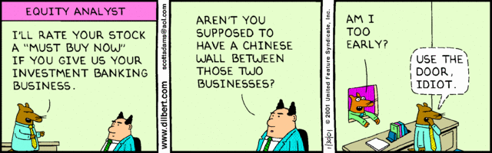
The Chinese-Wall model
Brewer and Nash (1989) proposed this model to handle the conflicts of interest that occur in many commercial environments.
In this case ...
  ... the subjects are analysts or consultants.
  ... the objects are information sets for companies.
Dilbert: 30-Jan-2001
Notes:
the potential for conflicts of interest and inadvertant disclosure of information by a consultant
or contractor.
A lawyer specializes in product liability and consults for
Qantas Airlines. It could be a breach of confidentiality for her to
consult also for Tiger Airlines. Why? A simultaneous contract
with McDonalds would not be a conflict.

Slide 47
The Chinese Wall Model
Hybrid model: addresses integrity and confidentiality
Addresses conflict of interest
  Models a consultancy business where analysts have to make sure that no conflicts arise when dealing with different clients (companies)
  Conflicts arise when clients are direct competitors in the same market, or because of the ownership of companies

Slide 48
Model elements
A set of subjects S: active entities interested in accessing protected objects
A set of companies C
A set of objects O:
  individual data items, each about a company
  The objects concerning the same company are called company datasets (DS)
  The function y: O -> C gives the company dataset for each object
The function x: O -> L(C) gives the conflict of interest classes for each object

Slide 49
The security label of an object o is the pair (x(o), y(o))
An object is sanitised if x(o) is empty
Conflicts of interest may also arise from objects that have been accessed in then past.
Let N(s,o) be true, if subject s has had access to object o, and false, if subject s never had access to object o

Slide 50
ss- property
A subject s is granted access to an object o only if for all objects o’ with N(s,o’)=true: either y(o) = y(o’) or y(o) does not belong to x(o’)
That is, access is granted only if the object requested belongs to:
  a company dataset already held by the subject (the analyst), or
  an entirely different conflict of interest class.

Slide 51
Star property
A subject s is granted write access to an object o only if s has no read access to an object o’ with y(o)≠y(o’) and x(o’) is not empty
That is, write access to an object is only granted if no other object can be read which is in a different company dataset and contains unsanitised information.

Slide 52
The Chinese Wall Model
Not a true multi-level secure model
The history of a subject’s access determines access control
Subject are only allowed access to info that is not held to conflict with any other info they already possess
Once a subject accesses info from one dataset, a wall is set up to protect info in other datasets in the same conflict of interest

Slide 53
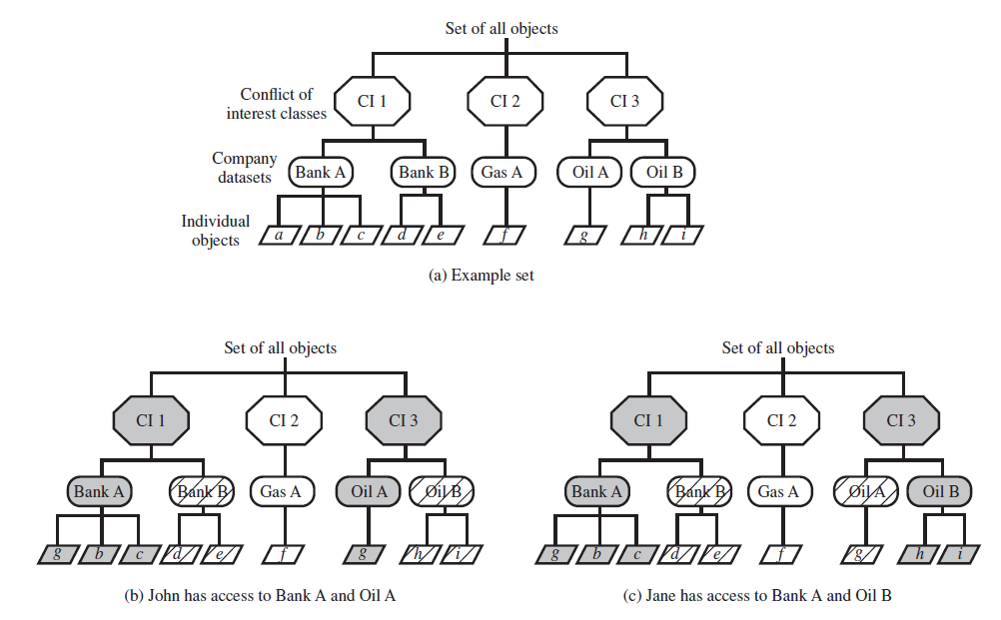
Figure 27.6 in [SB18]
Notes:
Simple sec rule (read): S can
read O if O is in the same dataset as
an object already accessed by S
OR O belongs to a Conflict of interest from which S has not yet accessed any info
*-property (write): S can write
O only if S can read O and all objects
that S can read are in the same DS
as O.
Figure 27.6a gives an example. There are datasets representing banks, oil companies,
and gas companies. All bank datasets are in one CI, all oil company datasets
in another CI, and so forth.
Figures 27.6b and c illustrate the operation of this rule. Assume at some point,
John has made his first read request to any object in this set for an object in the Bank
A DS. Because John has not previously accessed an object in any other DS in CI 1, the
access is granted. Further, the system must remember that access has been granted so
that any subsequent request for access to an object in the Bank B DS will be denied.
Any request for access to other objects in the Bank A DS is granted. At a later time,
John requests access to an object in the Oil A DS. Because there is no conflict, this
access is granted, but a wall is set up prohibiting subsequent access to the Oil B DS, as
shown in Figure 27.6b. Similarly, Figure 27.6c reflects the alternate access history of Jane.

Slide 54
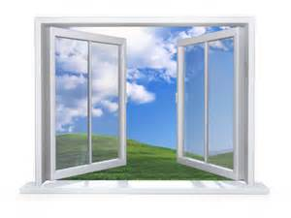

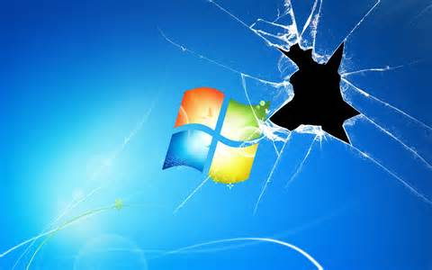
Access control: Windows
Locked
Unlocked
…
Open
Closed
Broken

Slide 55
Outline
Ctrl-Alt-Del.
ACL for Windows.
NTFS.
  EFS for NTFS.

Slide 56
Ctrl-Alt-Del
False login screens:
  Ctrl-Alt-Del is the secure attention sequence, used by Windows NT.
  It is guaranteed to take you to a genuine password prompt, it is a so-called trusted path.
But guaranteed is a loaded statement.
If the whole terminal is corrupted then it doesn’t help.
Anderson (“Security Engineering”) notes they once “caught a student installing modified keyboards in our public terminal room to capture passwords”.
If the attacker is prepared to go to such lengths, the ctrl-alt-del sequence just simplifies the software design task.
Notes:
Secure logon offers a keystroke sequence that cannot be intercepted by any application. When Secure Logon is enabled, no other malicious program can intercept your user name and password as you enter it.
Pressing Ctrl+Alt+Del ensures that the authentic Windows logon screen appears.
The secure attention key is designed to make login spoofing impossible, as the kernel will suspend any program, including those masquerading as the computer's login process, before starting a trustable login operation.
Login spoofings are techniques used to steal a user's password.
The user is presented with an ordinary looking login prompt for username and password, which is actually a malicious program, usually called a Trojan horse under the control of the attacker. When the username and password are entered, this information is logged or in some way passed along to the attacker, breaching security.

Slide 57
Access Control List
An ACL is an access control method employed by Windows NT, Windows 2000, Windows XP, Windows 7 … Windows 10
It is used to determine to what degree an account is allowed to access a resource.
Windows 95, Windows 98, Windows ME, and Windows CE do not support ACLs.
Notes:
ACL is the columns in Access Control Matrix

Slide 58
Windows NT, 2000, XP, 7..10 contain two types of ACLs:
  Discretionary access control lists (DACLs).
  System access control list (SACLs).
A DACL determines access rights to secured resources.
  A DACL can be attached to an object in the system.
A SACL determines audit policy for secured resources.
ACL’s are supported by NTFS
Notes:
An access control list (ACL) is a list of access control entries (ACE). Each ACE in an ACL identifies a trustee and specifies the access rights allowed, denied, or audited for that trustee. The security descriptor for a securable object can contain two types of ACLs: a DACL and a SACL.
A discretionary access control list (DACL) identifies the trustees that are allowed or denied access to a securable object. When a process tries to access a securable object, the system checks the ACEs in the object's DACL to determine whether to grant access to it. If the object does not have a DACL, the system grants full access to everyone. If the object's DACL has no ACEs, the system denies all attempts to access the object because the DACL does not allow any access rights. The system checks the ACEs in sequence until it finds one or more ACEs that allow all the requested access rights, or until any of the requested access rights are denied.
A system access control list (SACL) enables administrators to log attempts to access a secured object. Each ACE specifies the types of access attempts by a specified trustee that cause the system to generate a record in the security event log. An ACE in a SACL can generate audit records when an access attempt fails, when it succeeds, or both.
NTFS: New Technology File System

Slide 59
Common File Systems
Earlier versions of Windows (95, 98, ME) used File Allocation Tables (FAT and the 32-bit FAT32).
  They continue to be supported, primarily for backward compatibility, but FAT32 is also used for flash memory.
  We can convert between them using:
  convert c: /FS:NTFS
New Technology File System (NTFS) (http://www.ntfs.com)
  Designed for Windows NT, 2000, XP.
  Still used in Windows 10.
    You could use FAT32 or the older FAT (FAT16)…
  Supports file-level security, compression and auditing.
Notes:
NTFS permissions can be used to secure files and folders on an NTFS Partition. Unlike share permissions, NTFS permissions can be assigned to individual files as well as folders. Permissions can be assigned to individual users or groups of users. NTFS permissions apply to the local machine as well as the network.

Slide 60
NTFS Security
After user authentication to the Windows system via user name and password, NTFS provides another security layer.
It allows the system administrators to:
  Set access permissions to data using ACLs.
  Encrypt data and folders stored on an NTFS.
The last point is very important. NTFS has an Encrypting File System (EFS) that provides the core file encryption technology used to store encrypted files on NTFS volumes.
  EFS keeps files safe from intruders who gain unauthorized physical access to sensitive data, by, for example, stealing a computer.

Slide 61
The encryption is transparent with respect to users.
  Users work with encrypted files and folders as they do with any other files and folders. Decryption is automatic for authorised parties.
  If you send the files anywhere the encryption is removed.
EFS can:
  Encrypt files and folders on NTFS volumes.
  What is encryption?
    Providing confidentiality.
      What is confidentiality?
        …

Slide 62
The process is transparent with respect to authorized users, in the sense they don’t see any difference between accessing a protected file and accessing an unprotected file.
  When a file is accessed the authorization of the user is checked.
  If they are allowed to access the file it is decrypted, then accessed, and, generally, has encryption applied at the end. the file is opened it is decrypted saved, encryption is reapplied.
  Users who are not authorized to access the encrypted information receive an “Access denied” message.

Slide 63
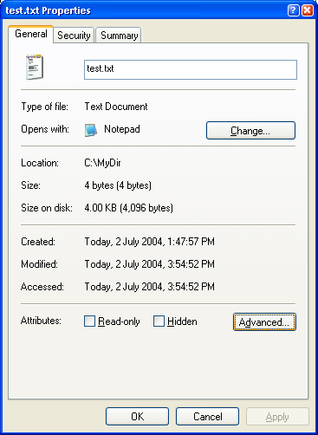
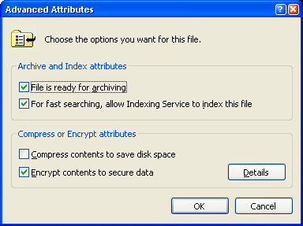
Windows XP

Slide 64
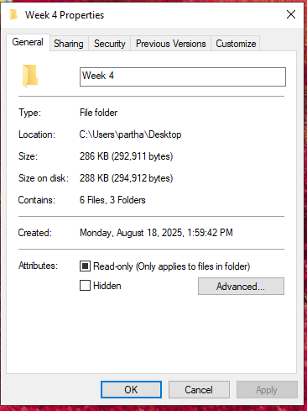
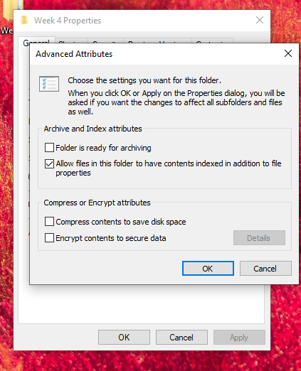
Windows 10

Slide 65
NTFS FOLDER PERMISSIONS
NTFS File Permission | Allowed Access
Read | This allows the user or group to view the files, folders, and subfolders of the parent folder. It also allows the viewing of folder ownership, permissions, and attributes of that folder.
Write | This allows the user or group to create new files and folders within the parent folder as well as view folder ownership and permissions and change the folder attributes.
List Folder Contents | This allows the user or group to view the files and subfolders contained within the folder.
Read & Execute | This allows the user or group to navigate through all files and subfolders including perform all actions allowed by the Read and List Folder Contents permissions.
Modify | This allows the user to delete the folder and perform all activities included in the Write and Read & Execute NTFS folder permissions.
Full Control | This allows the user or group to change permissions on the folder, take ownership of it, and perform all activities included in all other permissions.

Slide 66
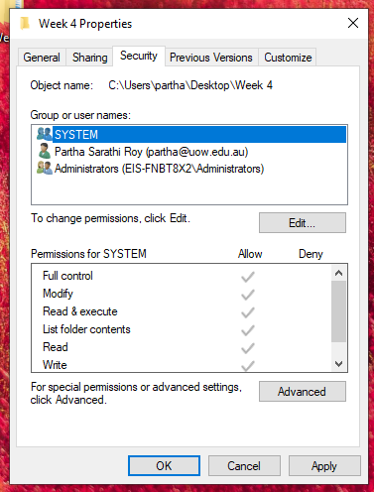
NTFS File Properties
Authenticated Users is the same as the Everyone group except it does not contain anonymous users.
Windows 10

Slide 67
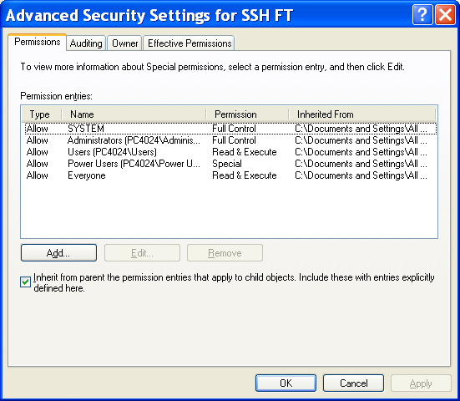
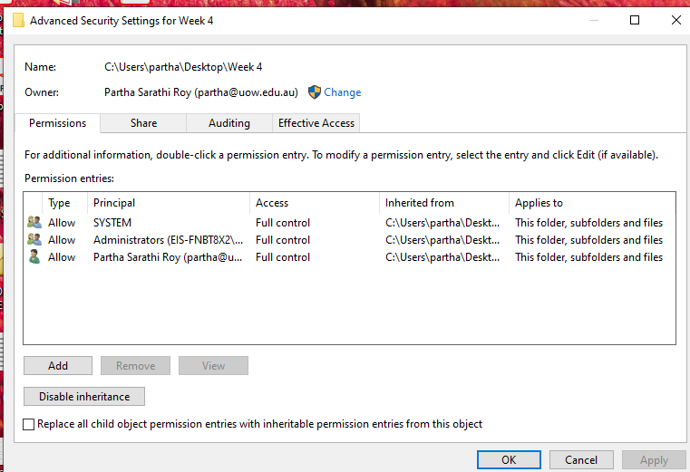
Advanced Settings
Windows XP
Windows 10

Slide 68
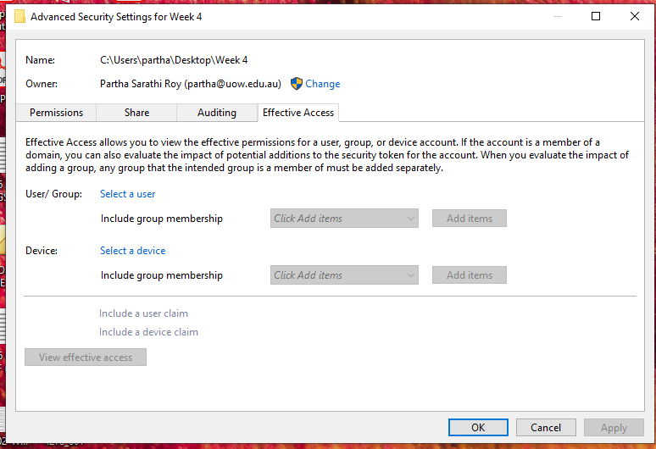
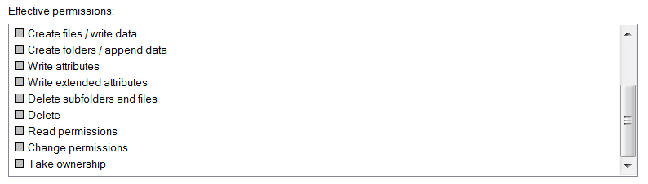
Windows 10

